Slide 1

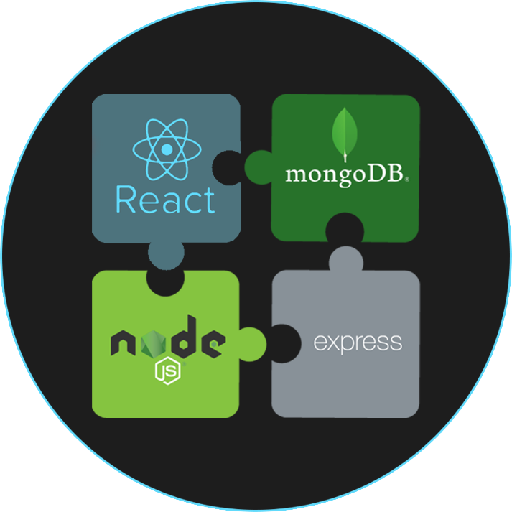
MERN Stack Front To Back
Welcome To The Course

Slide 2
Who Is This Course For?
People that want to learn to build and deploy a full stack application using the MERN stack
People that know at least the basics of React & Node.js
This is NOT an intro to React or Node.js course

Slide 3
Main Technologies Used
ES6+ JavaScript
Node.js / Express
MongoDB
React & Redux
Twitter Bootstrap 4
Heroku & Git For Deployment

Slide 4
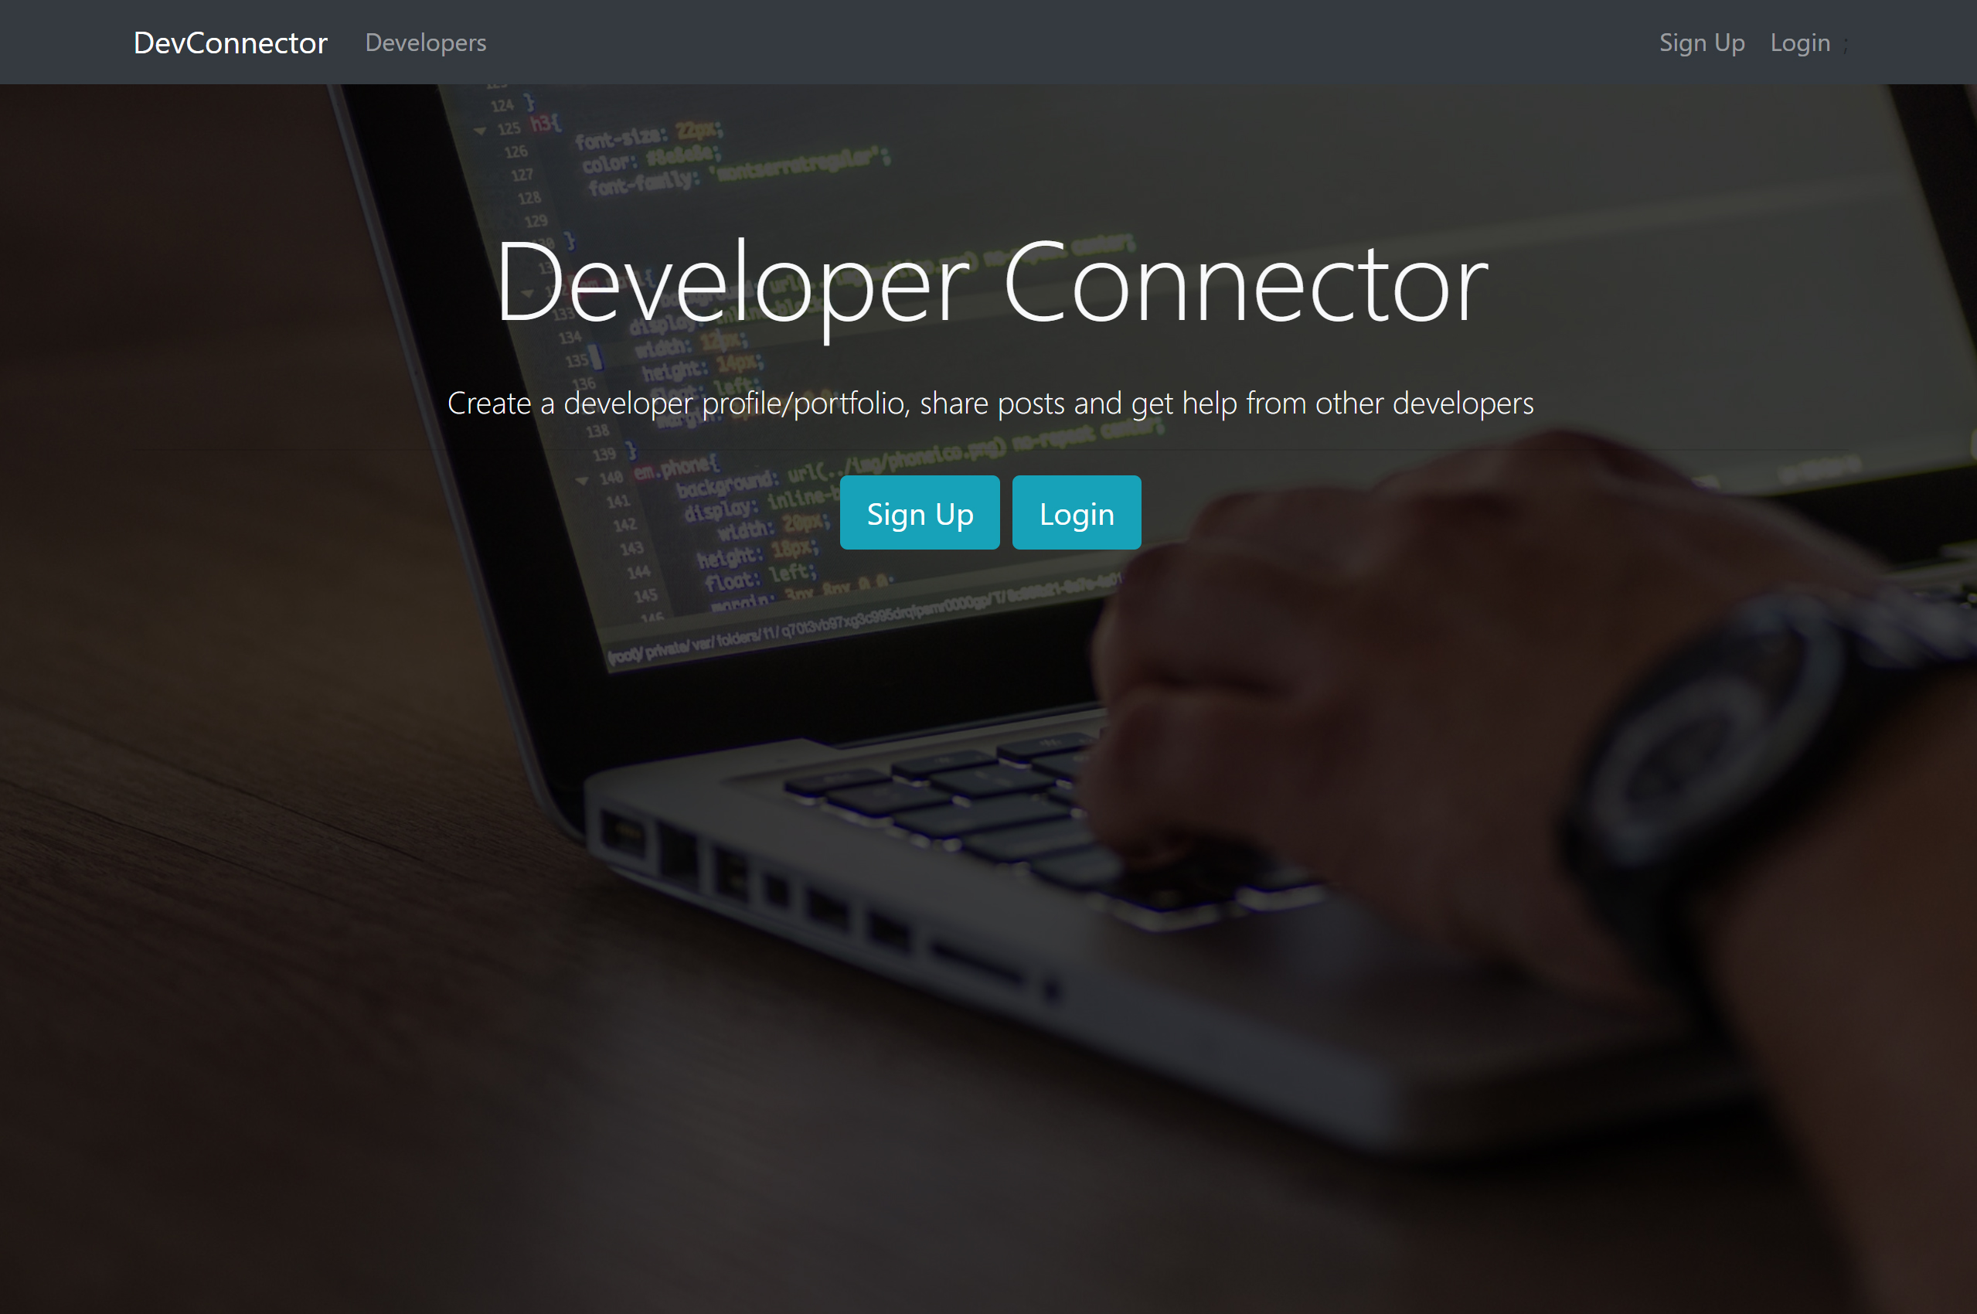
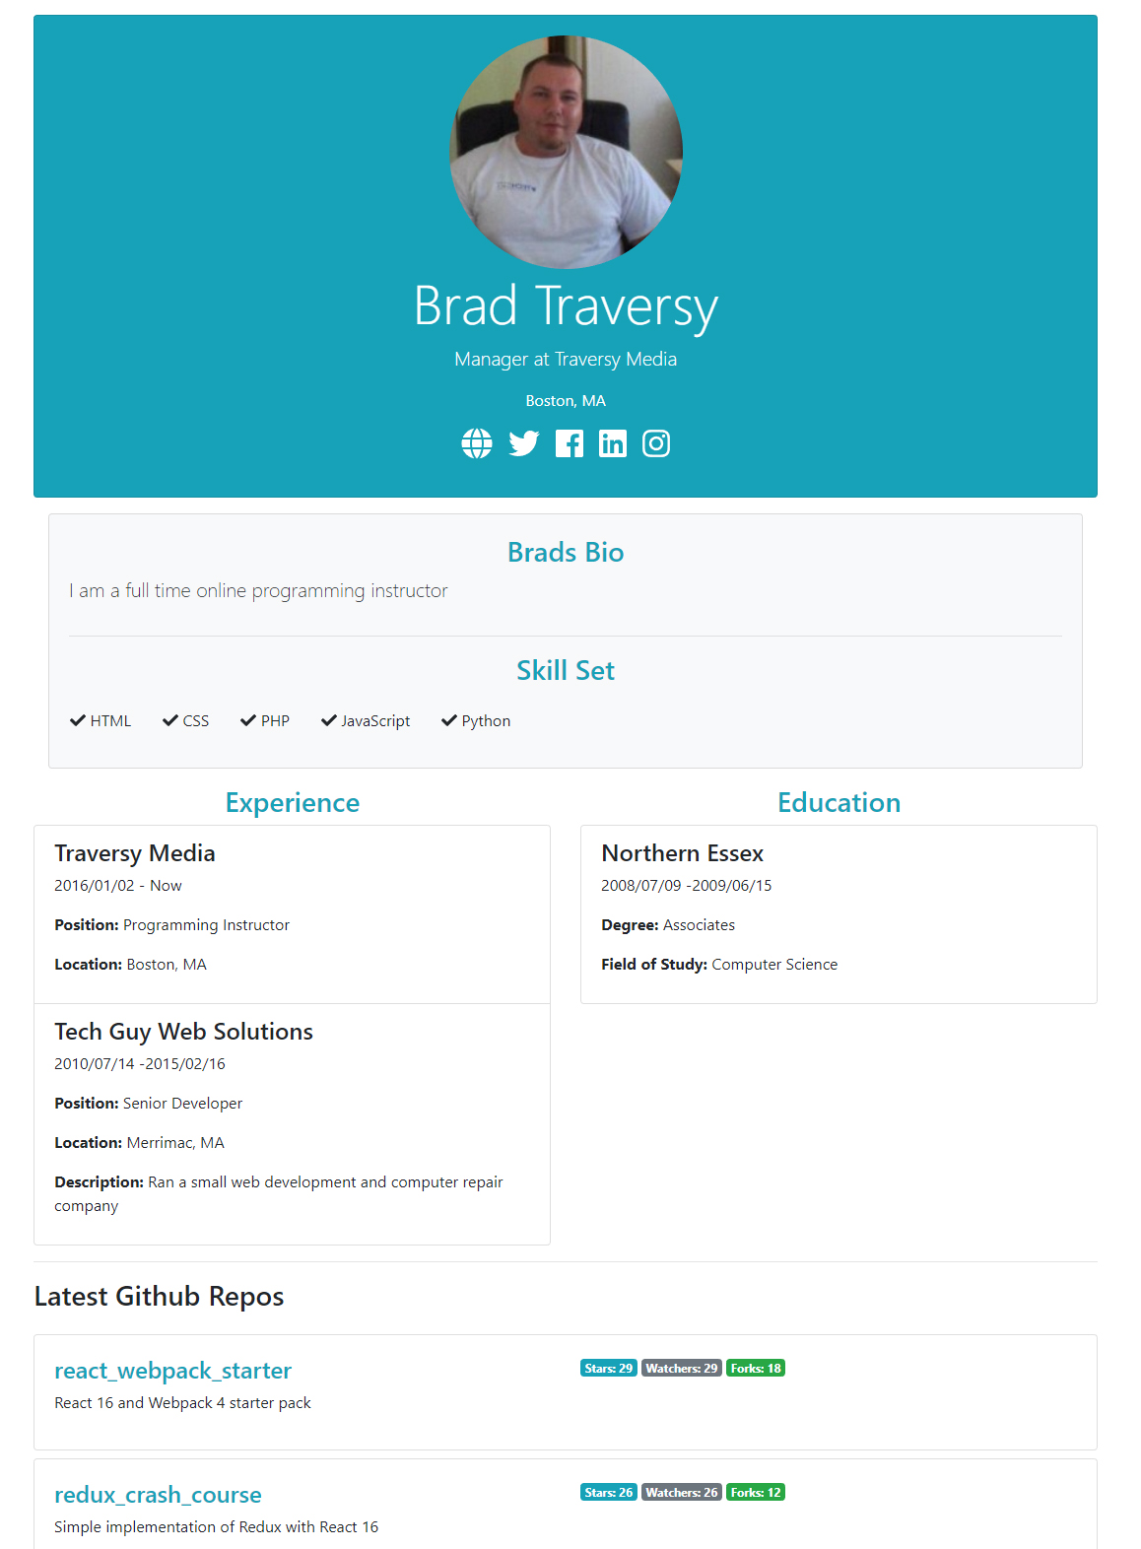
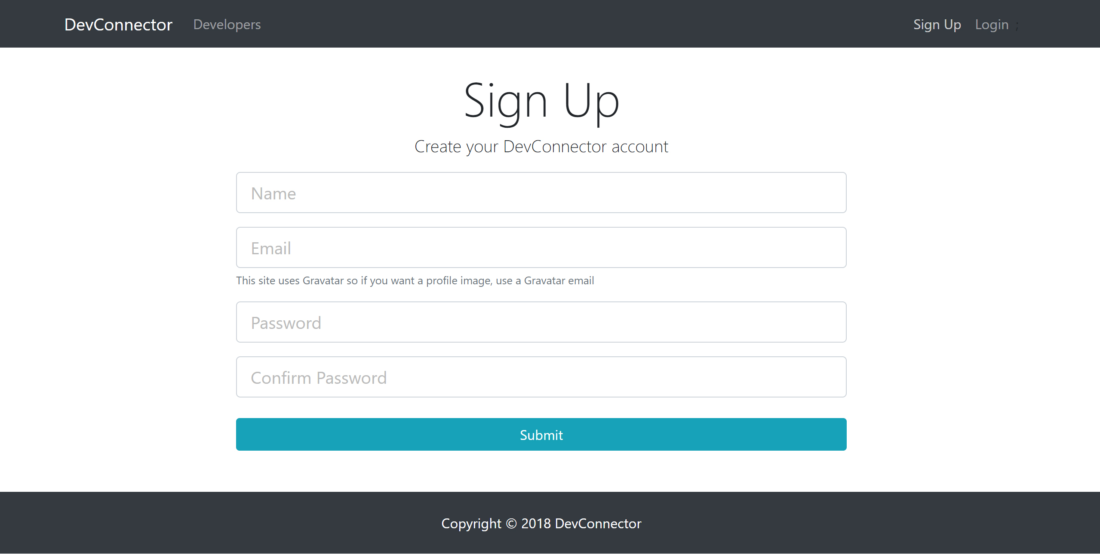
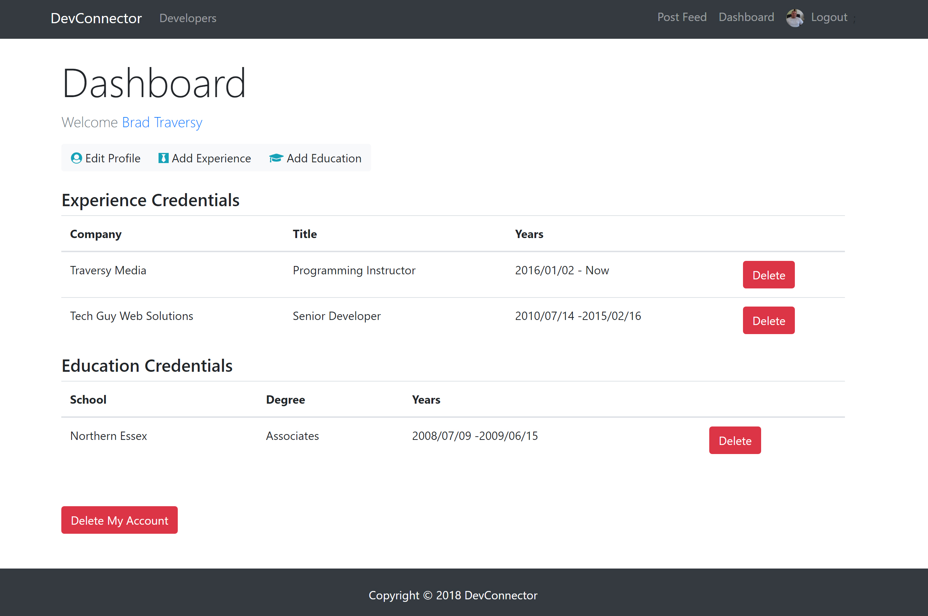
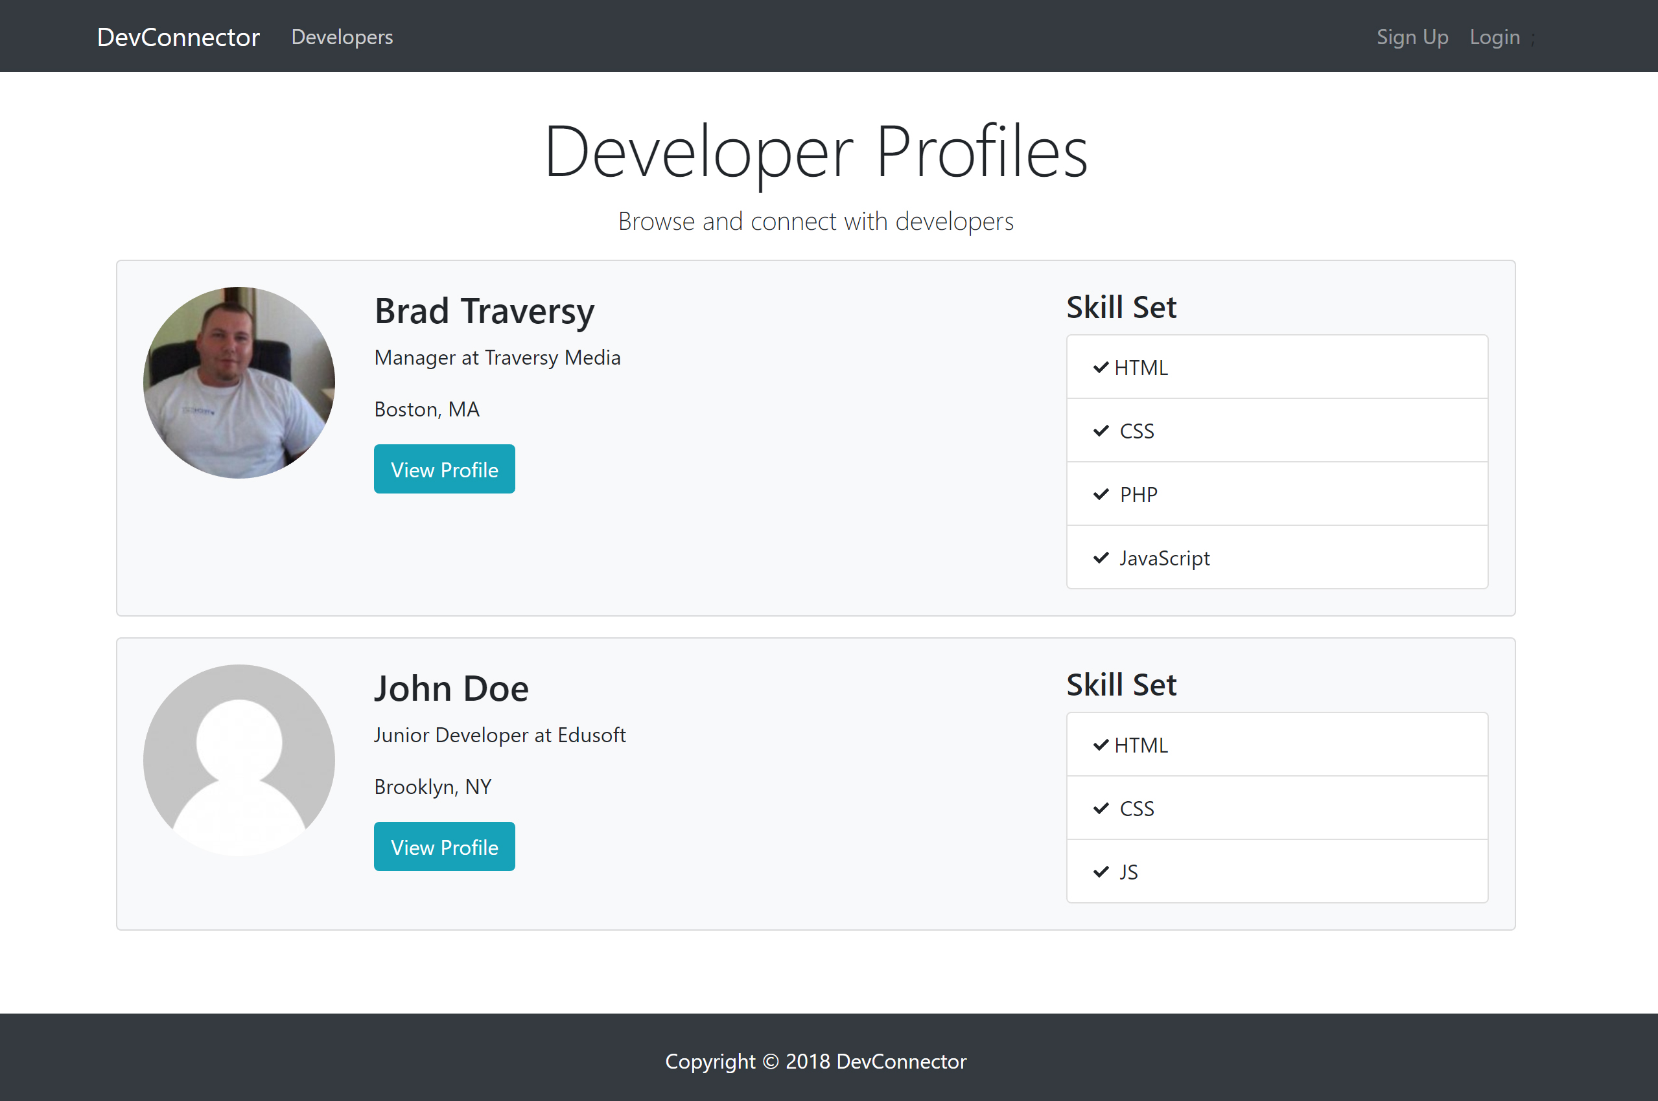
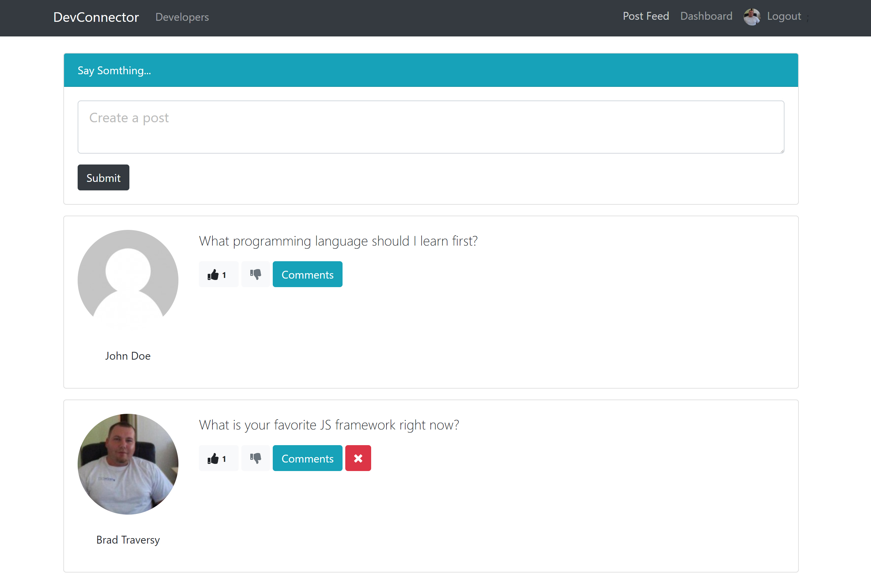
The Project
DevConnector
- Small social network with authentication, profiles, dashboard, posts

Slide 5
Course Plan
Create our backend API with Node/Express
Test with Postman
Create our custom Bootstrap theme UI (Optional)
Implement React and connect with the backend
Implement Redux for state management
Prepare, build & deploy to Heroku

Slide 6
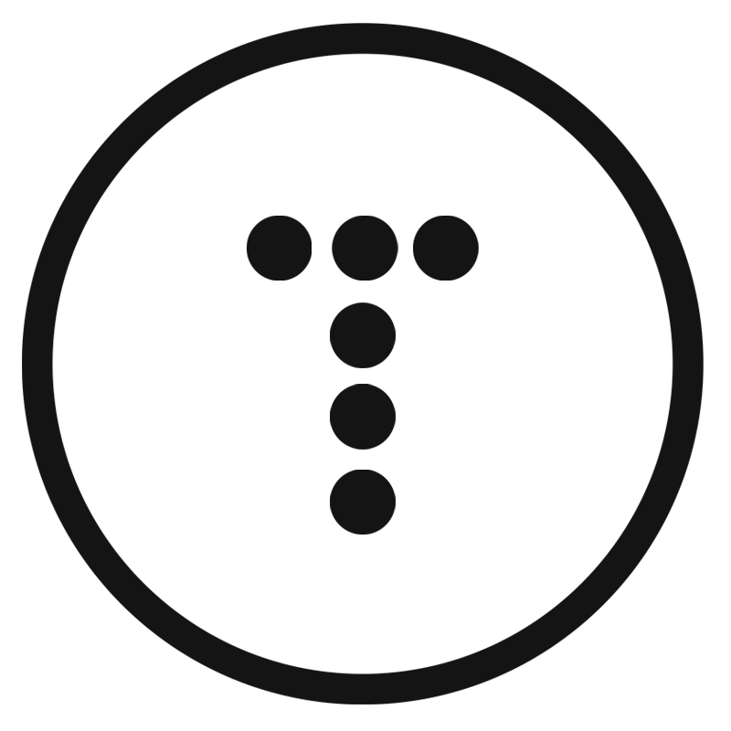





FOLLOW BRAD:
Youtube.com/c/traversymedia
Facebook.com/traversymedia
Twitter.com/traversymedia
Linkedin.com/in/bradtraversy
Thank You
For Watching!
www.traversymedia.com

